Slide 1
DHIS2 Analytics Database
With Apache Doris and ClickHouse
Lars Øverland | Bob Jolliffe

Slide 2



Problem
Countries have a lot of data
Dashboards are too slow and take > 1 min to load
Analytics table update takes too long at 12+ hours
Slow analytics queries impact entire application
Arguably the most significant challenge for DHIS2

Slide 3

Goals
Radical improvement to:
Analytics query performance (10x or more)
Analytics table update time (3x or more)
Modernization of analytics backend code:
Separation of analytics workload and application workload
Object orientation and abstraction
Improved test automation coverage

Slide 4

Approach
Dedicated analytics database architecture
Allow for future analytics database engines
Initial target databases are Apache Doris and ClickHouse
Plug-in architecture
Introduction of source code abstraction and unit tests
SqlBuilder
Database / Table / Column

Slide 5
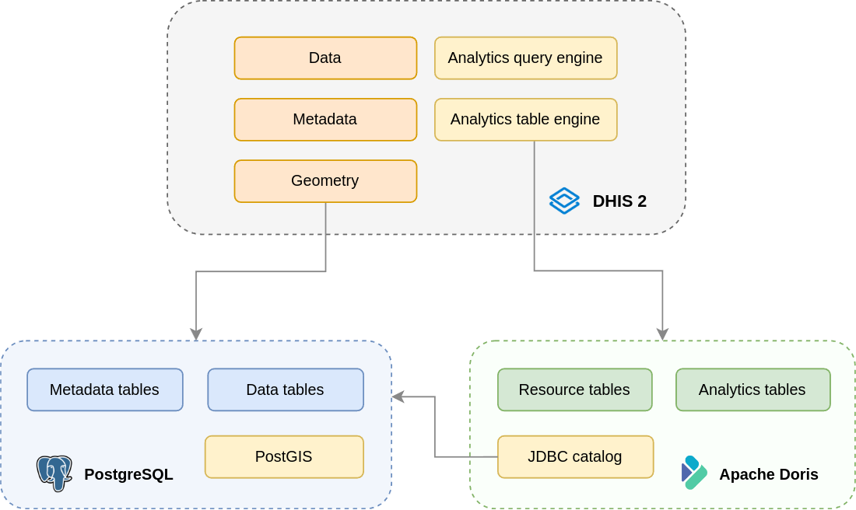
Analytics Database Architecture
Notes:
Data is transferred across using the JDBC catalog for PostgreSQL.

Slide 6
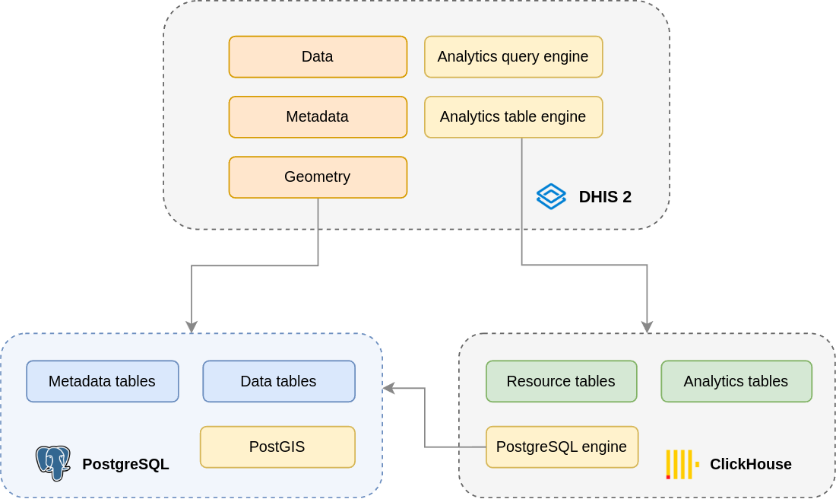
Analytics Database Architecture
Notes:
Data is transferred across using the PostgreSQL table engine.

Slide 7
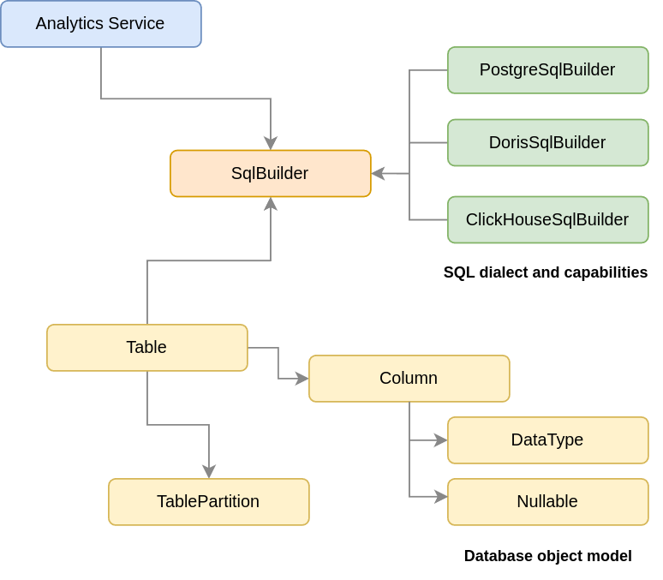
Software Abstraction Layer

Slide 8
Analytics Database Configuration (Doris)
# Analytics database management system
analytics.database = doris
# Analytics database connection URL
analytics.connection.url = jdbc:mysql://192.168.1.180:9030/analytics
# Analytics database username
analytics.connection.username = root
# Analytics database password
analytics.connection.password = admin
dhis.conf
https://docs.dhis2.org/en/manage/reference/analytics-database.html

Slide 9
Analytics Database Configuration (ClickHouse)
# Analytics database management system
analytics.database = clickhouse
# Analytics database connection URL
analytics.connection.url = jdbc:clickhouse://localhost:8123/default
# Analytics database username
analytics.connection.username = default
# Analytics database password
analytics.connection.password = admin
dhis.conf
https://docs.dhis2.org/en/manage/reference/analytics-database.html

Slide 10

Analytics Database Selection Criteria
Open source license
Widely adopted with strong community
High performance and high concurrency query engine
Transparent horizontal scalability
Comprehensive SQL support
JDBC driver and PostgreSQL integration
On-premise version
Well-documented installation process

Slide 11




Analytics Database Candidates
ClickHouse
Apache Druid
Apache Doris
DataBend

Slide 12
Analytics Database Performance Architecture
Columnar storage on disk
Less data to read
Faster disk seeks and reads
Data compression
Columns store similar data > higher compression
Sorting on insert
Reduces disk reads
Parallelization
Reads data in parallel threads
Utilizes available CPU cores
ClickHouse
Apache Doris

Slide 13
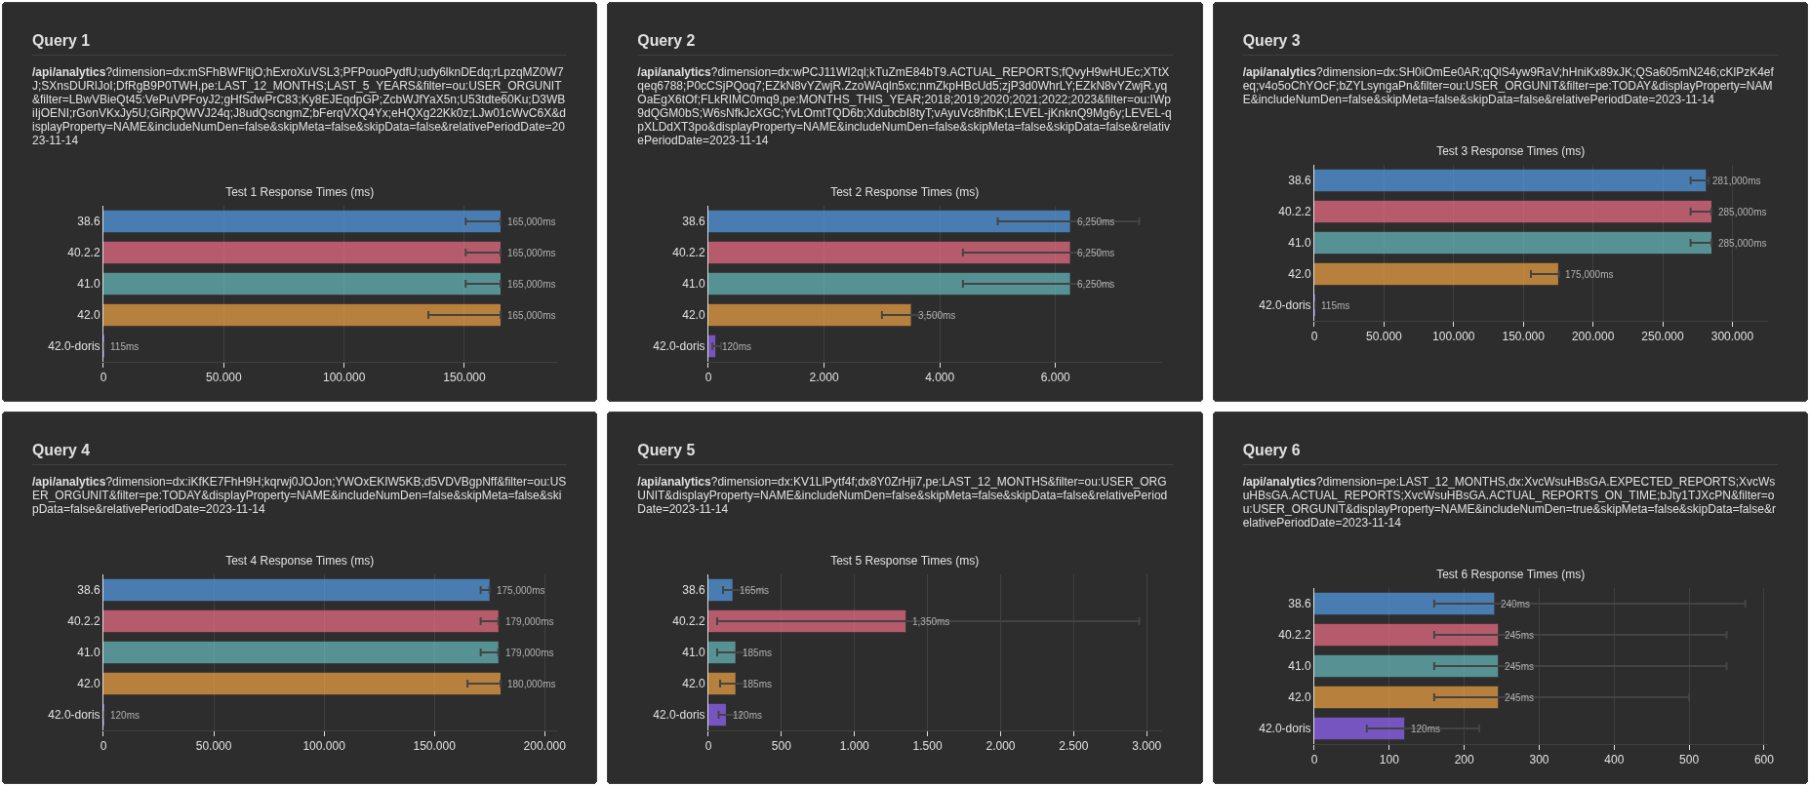
Gatling Benchmark on Doris ~28m Data Values

Slide 14
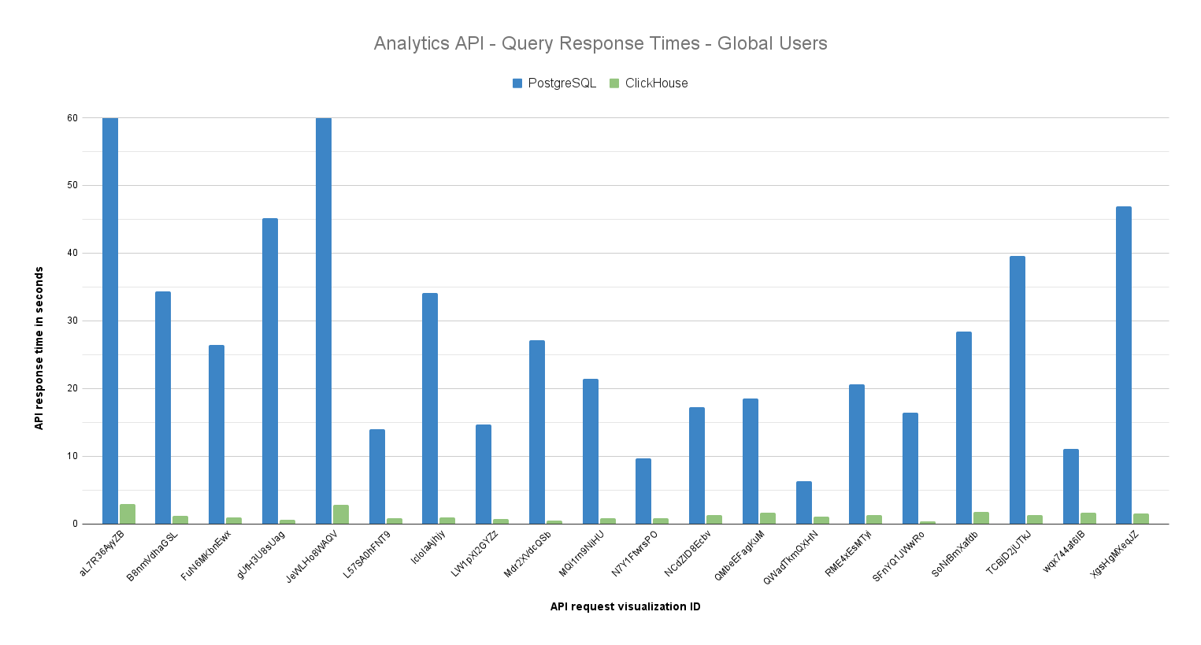
Benchmark on PEPFAR DB ~330m Data Values

Slide 15

Status - June 2026
2.42 - May 2025: Aggregate data and event analytics
2.43 - May 2026: Enrollment and tracker analytics
Full automated test suite for Apache Doris and ClickHouse
Thorough testing in test environments
Production use with Uganda DHIS2 e-registry (EMR)

Slide 16

Testing on Ghana HMIS (DHIMS2)
GHS facilitated an Apache Doris test server on a copy of HMIS data in their own infrastructure
Apache Doris installed on its own LXD container within the same virtual machine as DHIS2
Apache Doris playbook within dhis2-server-tools
No Apache Doris tuning done
Ghanaians celebrating finally having better performance

Slide 17



Benchmark Method
A collection of 24 hours analytics requests extracted from copy of the actual access logs on the production server
Requests were replayed to the test system with and without Doris and results compared

Slide 18
Ghana Benchmark Results
The DHIMS dashboards were already well set up - no pressing performance problems
No major speedup 90% of requests which were already fast, but the distribution was more compressed - no very slow requests
30’000 requests were returning the same result - a small number needed to be investigated
Resource consumption load on the transactional system was substantially reduced
Analytics table generation time was reduced from 90 min to 47 min

Slide 19
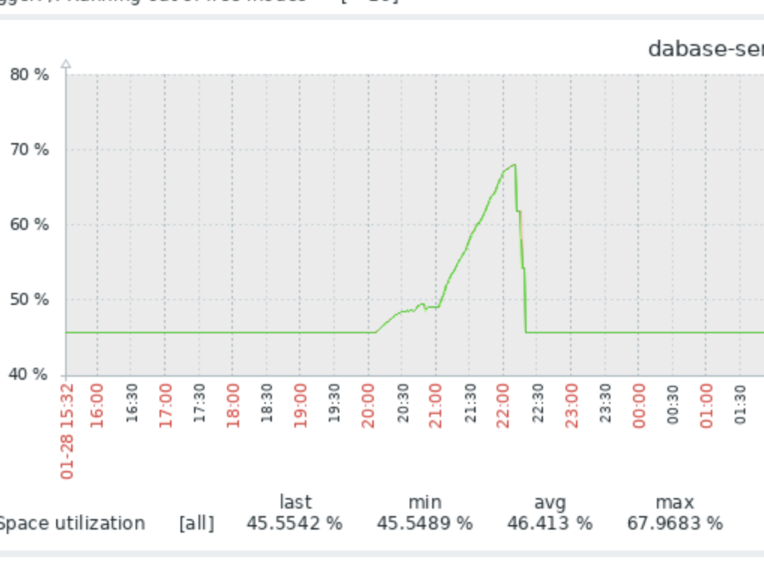
Conclusion from Ghana
There seems to be no downside in GHS adopting Apache Doris solution
Removal of the daily churn of analytics generation in the postgres database opens possibilities for:
Simple database replication
Incremental database backups
It would be safe to add more ambitious dashboards with Apache Doris

Slide 20
Frequently Asked Questions
Is this in Jira?
Apache Doris: DHIS2-16705
ClickHouse: DHIS2-18417
How do we handle lack of PostGIS?
Event clustering is not supported due to lack of PostGIS. The API will return 409. Information will be made available in the API system info to allow web apps to show/hide features.
How do we roll this out?
Build internal knowledge and experience with hosting Doris and ClickHouse in production environments. Create installation and hosting guidance.
Will Doris/ClickHouse be used for everything?
PostgreSQL remains as the transactional database, i.e. metadata and data remains in PostgreSQL. Doris / ClickHouse will be used for analytics tables only.
Are we locking ourselves to one database engine?
With the new architecture, future analytics database engines can fairly easily be supported by implementing the SqlBuilder interface and adding the JDBC driver.

Slide 21

Thank you!

